Slide 1
Proyect: FinanceGuard
By:
Sara Henao
Data scientist

Slide 2

Contexto
FinanceGuard is a digital bank that has experienced exponential growth in recent years, reaching 10,000 active customers. However, management has detected a concerning increase in the customer churn rate, which currently stands at 20% annually, resulting in losses amounting to millions.
Objective: Reduce FinanceGuard's banking churn from 20% annually to 15% annually. A 5% reduction in churn.
"According to global financial industry studies (such as those published by Bain & Company and Harvard Business Review), acquiring a new customer is between 5 and 25 times more expensive than retaining an existing one. Therefore, the development of this Machine Learning model has a high financial justification, focusing on the efficiency of retention spending."[1]

Slide 3
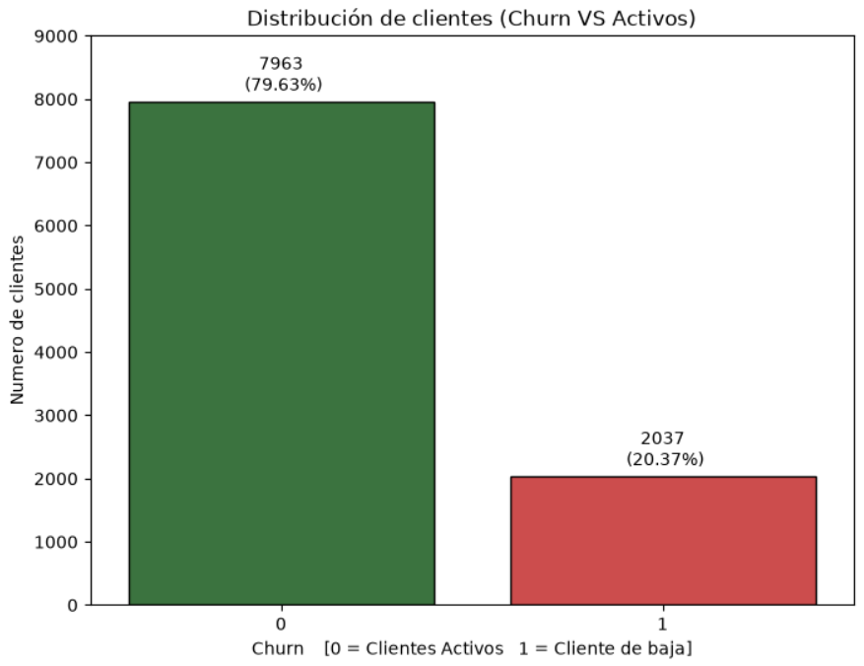
Methodology
3 milestones: Data cleaning and exploration (EDA) were performed, and supervised models were developed, including logistic regression, Random Forest, XGBOOST, LightGBM, CatBoost, and Stacking (XGBOOST, LightGBM, CatBoost), as well as the development of unsupervised models—K-Means and DBSCAN—for customer segmentation and profile identification using dimensionality reduction techniques such as PCA (Principal Component Analysis) and t-SNE.
Financial Impact:
Total annual loss of deposit capacity:
€185,588,094.63
Average annual loss of deposit capacity per customer:
€91,108.54

Slide 4
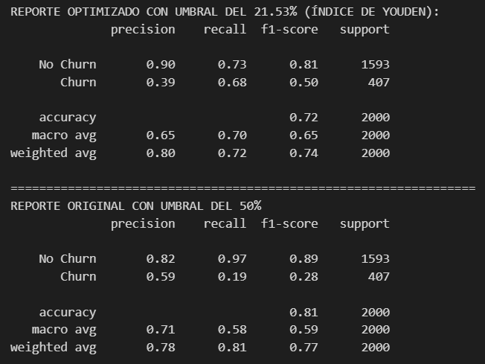
Key findings:
Optimization of the logistic regression base model using the Youden index, increasing its recall from 19% to 68% with a classification accuracy of 77% (ROC-AUC)
ROC_AUC = 0.77

Slide 5
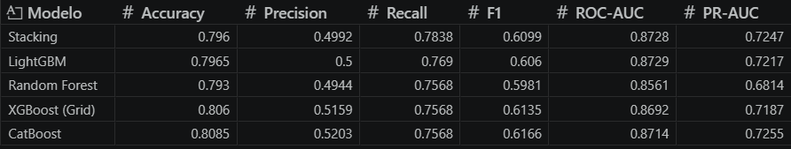
Best predictive model
Best supervised model: Stacking (XGBoost + LightGBM + CatBoost) with an ROC-AUC of 0.872 and a recall of 0.7838. It tied with LightGBM and was surpassed by only a 1.48% difference in recall. In financial terms, this difference represents the identification of €2.7 million per year.

Slide 6
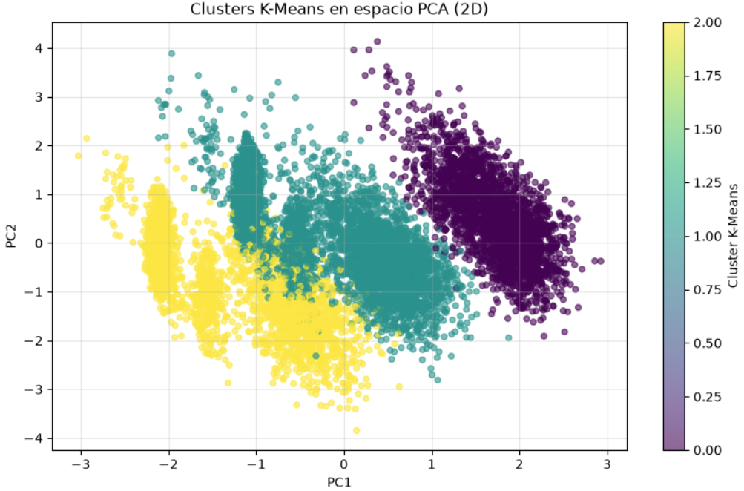
Proposed Actions
Segmentation: K-Means with K=3 identifies a high-risk cluster (Germany, 32.4% churn) compared to 16% in other segments. Identification of specific at-risk profiles using t-NSE could contribute up to 1.48% toward reducing overall churn.Key Variables: Geography, Balance, NumOfProducts, and IsActiveMember are the most important predictors in the segmentation.

Slide 7
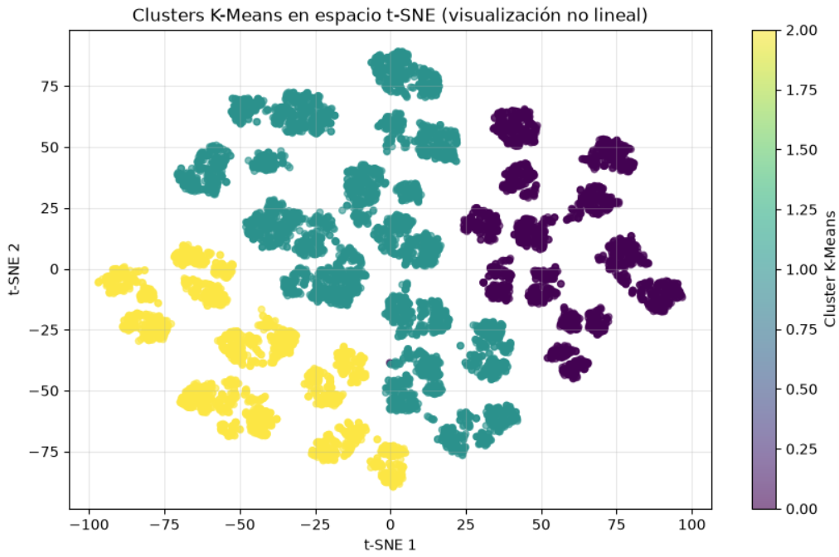
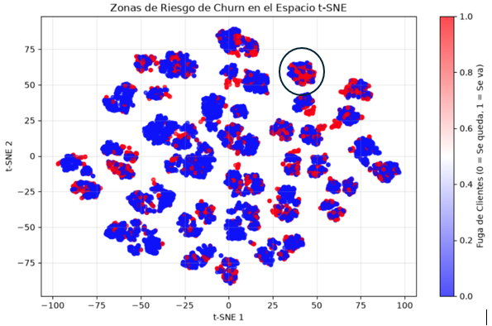
Proposed Actions
Cluster 0: Priority focus on retention strategies, review of the German experience, and possible product/price adjustments. Total customers: 25.09% (2,509) with a 32.4% churn rate; accounts for 8.13% of the 20% churn rate
Clusters 1 and 2: With churn rates below 20%, these clusters are stable and suitable for growth strategies, benchmarking, and cross-selling, without neglecting basic retention.
DBSCAN generated many outliers (homogeneous data) in this dataset; K-Means proved more useful for actionable segmentation.
T-SNE can complement K-Means segmentation. By taking action on specific groups, for example: one of the clusters that visually has the highest concentration of churn is selected—the one located between the coordinates for t-SNE1 [25–50] and t-SNE2 [50–75]—which has a local churn rate of 53% for a cluster of 277 customers. This would ultimately contribute 1.47% to the overall churn rate, out of the 5% target.

Slide 8
Bibliography
[1] A. Gallo, "The Value of Keeping the Right Customers," Harvard Business Review, 2014.

